Slide 1
Contents | No
ALL CONTENTS | 2
BREADTH FIRST TRAVERSAL | 3
BREADTH FIRST _ RULES | 4
BREADTH FIRST _ EXAMPLE | 5
BREADTH FIRST _ EXAMPLE | 6
BREADTH FIRST _ EXAMPLE | 7
BREADTH FIRST _ EXAMPLE | 8
BREADTH FIRST _ EXAMPLE | 9
BREADTH FIRST _ EXAMPLE | 10
BREADTH FIRST _ EXAMPLE | 11
BREADTH FIRST _ EXAMPLE | 12
BREADTH FIRST _ EXAMPLE | 13
BREADTH FIRST _ CODE | 14
BREADTH FIRST _ CODE | 15
BREADTH FIRST _ CODE | 16
BREADTH FIRST _ CODE | 17
BREADTH FIRST _ CODE | 18
DEPTH FIRST TRAVERSAL | 19
DEPTH FIRST _ RULES | 20
DEPTH FIRST _ EXAMPLE | 21
DEPTH FIRST _ EXAMPLE | 22
DEPTH FIRST _ EXAMPLE | 23
DEPTH FIRST _ EXAMPLE | 24
DEPTH FIRST _ EXAMPLE | 25
DEPTH FIRST _ EXAMPLE | 26
DEPTH FIRST _ EXAMPLE | 27
DEPTH FIRST _ EXAMPLE | 28
DEPTH FIRST _ CODE | 29
DEPTH FIRST _ CODE | 30
DEPTH FIRST _ CODE | 31
DEPTH FIRST _ CODE | 32
DEPTH FIRST _ CODE | 33
CONNECTIVITY | 34
CONNECTED GRAPH | 35
STRONGLY/WEAKLY CONNECTED | 36
CONNECTED COMPONENT | 37
N-CONNECTED GRAPH | 38

Slide 2
GRAPH
Traversal:
Breadth First traversal
Depth First traversal
Connectivity:
Connected graph
Definition
Strongly/Weakly connected
N-connected graph

Slide 3
BREADTH FIRST TRAVERSAL

Slide 4
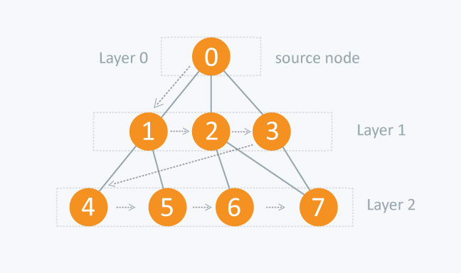
BREADTH FIRST TRAVERSAL
RULES:
Start with a chosen vertex 0
1
Visit all adjacent unvisited vertices of 0, suppose vertex 1, 2, 3,... Print 0
2
Repeat step ② with vertex 1, 2… until all vertices are visited (each vertex is visited only one)
3

Slide 5
BREADTH FIRST TRAVERSAL
BreadthFirst (‘A’);
A
A
G
Queue=
A
B C D
D
B
C
D
B
C
Print=
E
F
A
Visit adjacent vertices of A
Start with A

Slide 6
BREADTH FIRST TRAVERSAL
BreadthFirst (‘A’);
A
A
G
Queue=
B C D
D
B
C
D
B
C
Print=
E
E
F
A
Repeat with B

Slide 7
BREADTH FIRST TRAVERSAL
BreadthFirst (‘A’);
A
A
G
Queue=
C D E
D
B
C
D
B
C
Print=
E
F
A B

Slide 8
BREADTH FIRST TRAVERSAL
BreadthFirst (‘A’);
A
A
G
Queue=
C D E
D
B
C
D
B
C
Print=
E
F
A B

Slide 9
BREADTH FIRST TRAVERSAL
BreadthFirst (‘A’);
A
A
G
Queue=
D E
D
B
C
D
B
C
Print=
E
F
A B C

Slide 10
BREADTH FIRST TRAVERSAL
BreadthFirst (‘A’);
A
A
G
G
Queue=
D E
D
B
C
D
B
C
Print=
E
F
F
A B C

Slide 11
BREADTH FIRST TRAVERSAL
BreadthFirst (‘A’);
A
A
G
G
Queue=
E F G
D
B
C
D
B
C
Print=
E
F
F
A B C D

Slide 12
BREADTH FIRST TRAVERSAL
BreadthFirst (‘A’);
A
A
G
G
Queue=
E F G
D
B
C
D
B
C
Print=
E
F
F
A B C D

Slide 13
BREADTH FIRST TRAVERSAL
BreadthFirst (‘A’);
A
A
G
G
Queue=
D
B
C
D
B
C
Print=
E
F
F
A B C D E F G
All vertices are visited

Slide 14
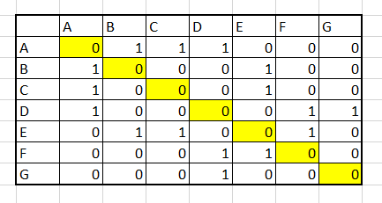
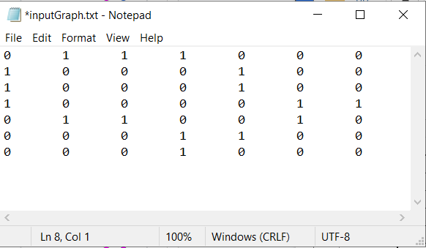
BREADTH FIRST TRAVERSAL
CODE
Breadth First with Java
A
G
(Take graph G as an example)
B
C
D
E
F
STEP 1: Convert graph G into adjacency matrix, then save as a .txt file
Graph G
.txt file name “inputGraph.txt”

Slide 15
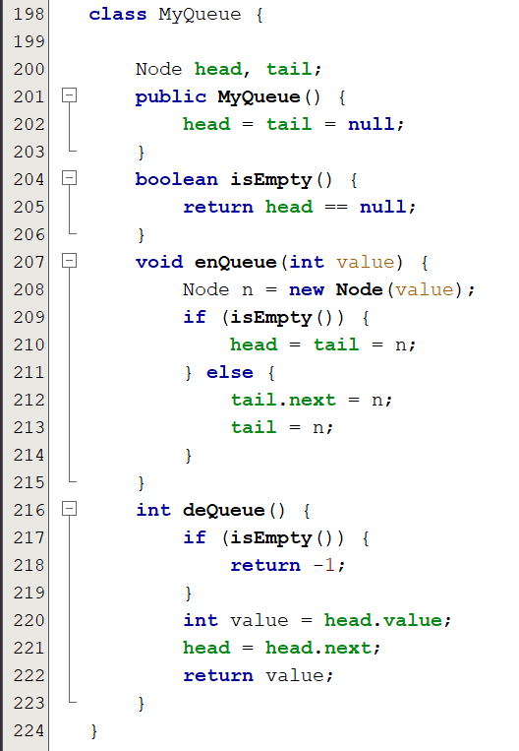
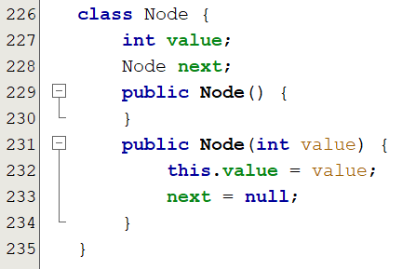
BREADTH FIRST TRAVERSAL
CODE
STEP 2: Write two classes:
Node represents a vertex;
MyQueue represents list of visited vertices

Slide 16
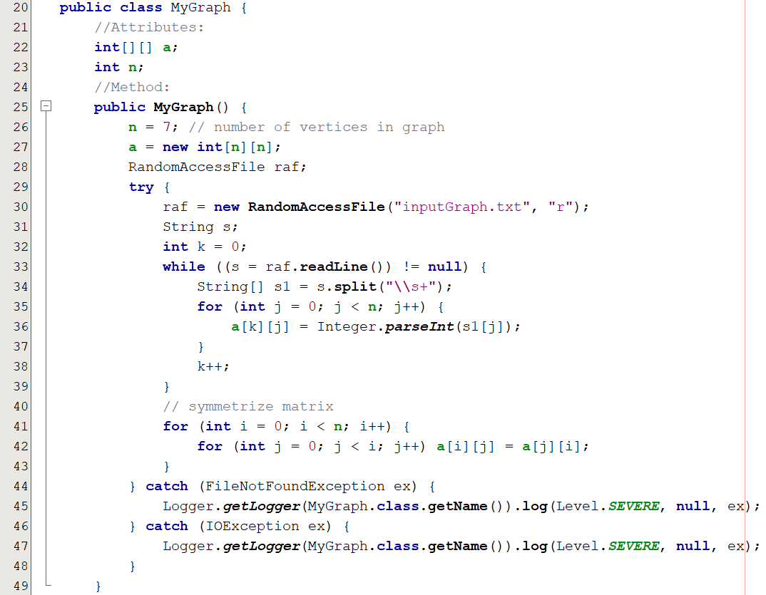
BREADTH FIRST TRAVERSAL
CODE
STEP 3: Class MyGraph implement BreadthFirst
constructor MyGraph() read the .txt file “inputGraph.txt”

Slide 17
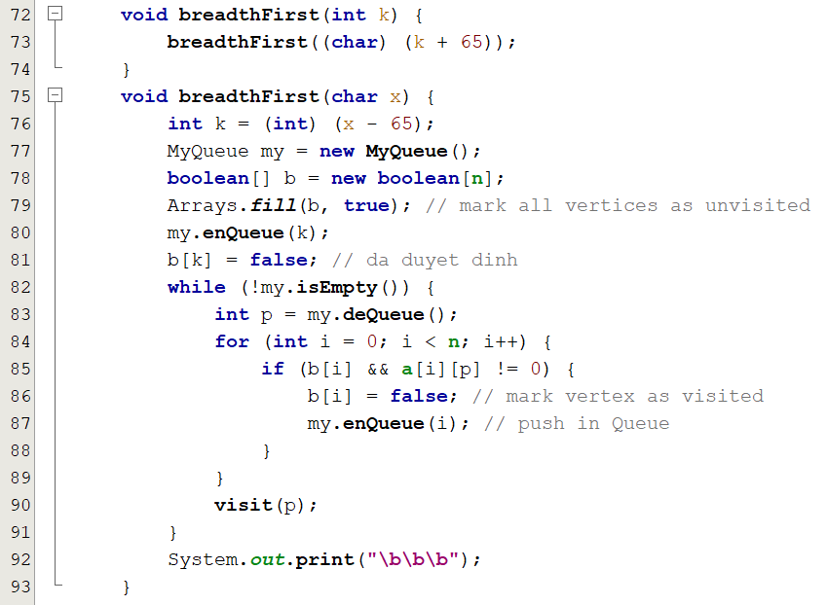
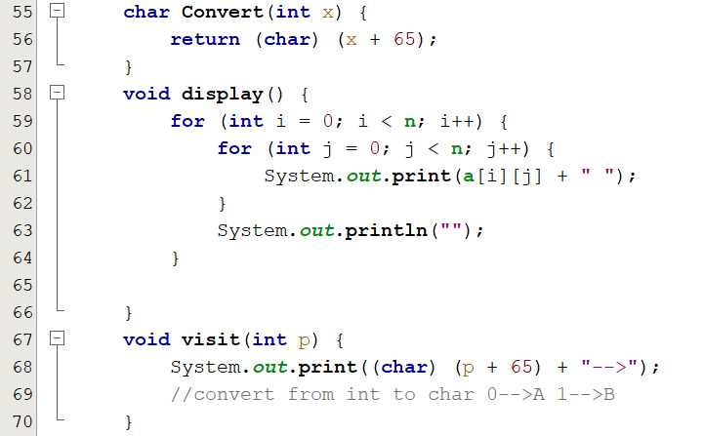
BREADTH FIRST TRAVERSAL
CODE
STEP 3: Class MyGraph implement BreadthFirst
// Breadth First code:
// Functions to display the result

Slide 18
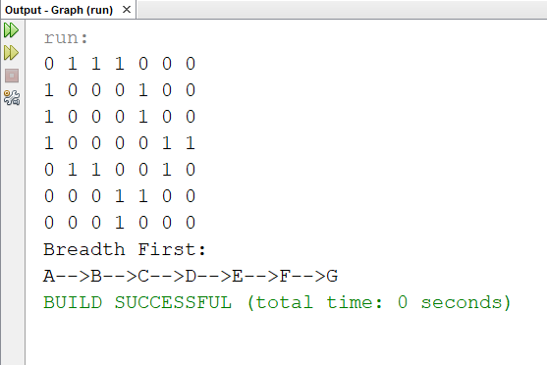
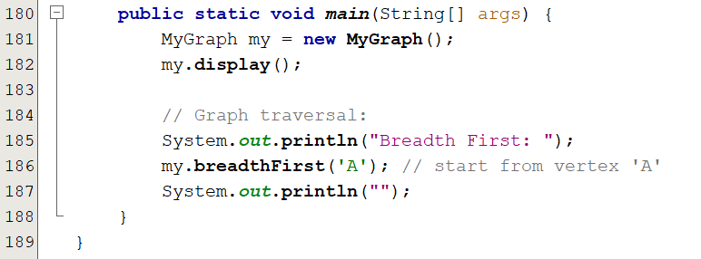
BREADTH FIRST TRAVERSAL
CODE
STEP 4: Run program
// Output
// Main function

Slide 19
DEPTH FIRST TRAVERSAL

Slide 20
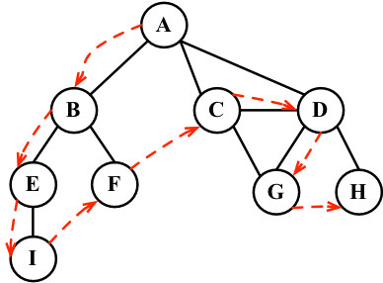
DEPTH FIRST TRAVERSAL
RULES:
Start with a chosen vertex A
1
Visit unvistited adjacent vertex of A at the top, suppose B
2
Repeat step ② with B, if there is no adjacent, repeat with parent vertex until all vertices are visited
3

Slide 21
DEPTH FIRST TRAVERSAL
DepthFirst (‘A’);
A
A
G
Queue=
B
A
B
D
B
C
Print=
E
F
A
Find unvisited adjacent vertex of A
Start from A

Slide 22
DEPTH FIRST TRAVERSAL
DepthFirst (‘A’);
A
A
G
Queue=
B
B
D
B
C
Print=
E
E
F
A

Slide 23
DEPTH FIRST TRAVERSAL
DepthFirst (‘A’);
A
A
G
Queue=
E
B
D
B
C
Print=
E
E
F
A B

Slide 24
DEPTH FIRST TRAVERSAL
DepthFirst (‘A’);
A
A
G
Queue=
C
B
C
D
B
C
Print=
E
E
F
A B E
A has been visited

Slide 25
DEPTH FIRST TRAVERSAL
DepthFirst (‘A’);
A
A
G
Queue=
F
B
D
B
C
D
C
Print=
E
E
F
F
A B E C
Visit other unvisited adjacent vertex of E

Slide 26
DEPTH FIRST TRAVERSAL
DepthFirst (‘A’);
A
A
G
G
Queue=
D
B
D
B
C
D
C
Print=
E
E
F
F
A B E C F
A has been visited

Slide 27
DEPTH FIRST TRAVERSAL
DepthFirst (‘A’);
A
A
G
G
Queue=
G
B
D
B
C
D
C
Print=
E
E
F
F
A B E C F D

Slide 28
DEPTH FIRST TRAVERSAL
DepthFirst (‘A’);
A
A
G
G
Queue=
B
D
B
C
D
C
Print=
E
E
F
F
A B E C F D G
All vertices are visited

Slide 29
DEPTH FIRST TRAVERSAL
CODE
Depth First with Java
A
G
(Take graph G as an example)
B
C
D
#Note: Step 1, 2 are the same as BreadthFirst
E
F
STEP 1: Convert graph G into adjacency matrix, then save as a .txt file
Graph G
.txt file name “inputGraph.txt”

Slide 30
DEPTH FIRST TRAVERSAL
CODE
STEP 2: Write two classes:
Node represents a vertex;
MyQueue represents list of visited vertices

Slide 31
DEPTH FIRST TRAVERSAL
STEP 3: Class MyGraph implement DepthFirst
constructor MyGraph() read the .txt file “inputGraph.txt”

Slide 32
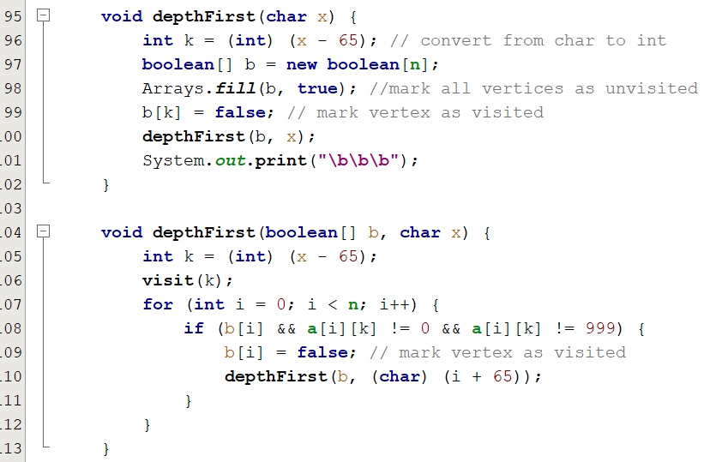
DEPTH FIRST TRAVERSAL
STEP 3: Class MyGraph implement DepthFirst
// Depth First code:
// Functions to display the result

Slide 33
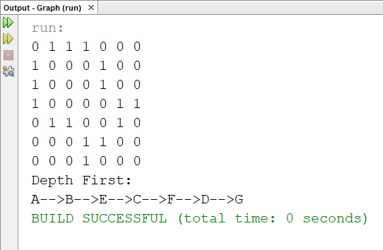
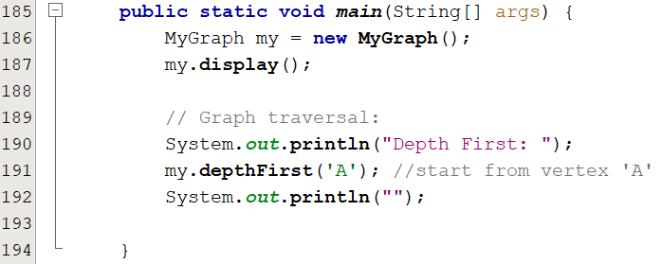
DEPTH FIRST TRAVERSAL
// Output
// Main function

Slide 34
CONNECTIVITY

Slide 35
GRAPH CONNECTIVITY
CONNECTED GRAPH
Definition:
Examples:
B
A, C are connected through path A->B->C
A, B are CONNECTED: there is a path which starts at A and ends at B.
D
A
C
A, D are not connected
A
A
Graph G is CONNECTED: if all vertices are connected to each other.
E
G
D
E
D
B
C
B
C
F
F
Graph G1 is not connected
Graph G2 is connected

Slide 36
GRAPH CONNECTIVITY
Definition:
Examples:
A
Strongly connected: can get form A to B and from B to A in the graph
B
F
D
C
E
Weakly connected: can get from A to B in underlying undirected graph
A
B
F
D
C
E

Slide 37
GRAPH CONNECTIVITY
CONNECTED COMPONENTS
Definition:
Examples:
A connected component: in a graph G is a set of vertices such that all vertices in it are connected
A
E
D
There components in graph G:
{A,B,C}
{D,E,F}
{G}
G
A CUT-VERTEX: if we remove it, the number or components increase
B
C
F
Graph G
A
A
D
D
C
F
F
B
E
B
E
Graph H
Graph H1

Slide 38
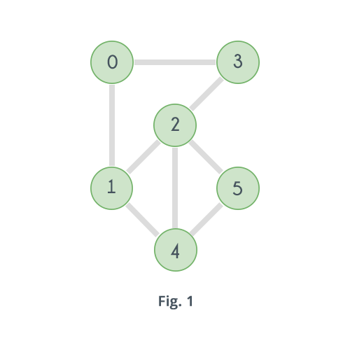
GRAPH CONNECTIVITY
DEGREE OF GRAPH
Definition:
A n-connected graph: it remains connected if we remove no more than k-1 vertices
2-connected or bioconnected:
remains connected if we remove 1 vertices

